Slide 2
Genome assembly and what we can get
Mikael Lenz Strube (milst@dtu.dk)

Slide 3
Bacterial genomes and how to sequence them
Fragment to short reads
Library prep
Purify
Sequence
(Illumina)
Assemble
contigs
Sequence
(Nanopore)
Hybrid
Assemble
Fragment to long reads
Library prep
complete
genome

Slide 4
Getting genomes
There are more genomes sequenced than we can ever make sense of
The gold standard (debatable by now) database is NCBI, which contains basically everything through a multitude of secondary databases
https://www.ncbi.nlm.nih.gov/genome/browse#!/prokaryotes/
It is surprisingly difficult to download genomes from NCBI, but luckily Kai Blinn has made a command line tool for us to use, allowing us to download specific sets of genomes.
We will be working only with fasta files of complete genomes.
>Chromosome 1
AGCGTGCGGTAAATGCCCGTGAGGAG….

Slide 5
Gene content
The genome is the menu
The transcriptome is the order to the kitchen
The proteome is the actual dish coming out
ATG……TAA
BAKTA uses prodigal for annotation, which is a HMM-based gene finder
It also uses some extra programs to find rRNA etc (also HMM based)
It then uses BLAST and more HMMs to annotate the genes
The result is a pretty good overview of the genes of the genome
BAKTA is very common in the bioinformatics world, due to ease and speed

Slide 6
Gene annotation
AGATGCCAGTTCGGG….TAA
Gene database
HMM database
Pectin lyase

Slide 7
Annotation formats
.gff | This is the master annotation in GFF3 format, containing both sequences and annotations. It can be viewed directly in Artemis or IGV.
.gbk | This is a standard Genbank file derived from the master .gff. If the input to prokka was a multi-FASTA, then this will be a multi-Genbank, with one record for each sequence.
.fna | Nucleotide FASTA file of the input contig sequences.
.faa | Protein FASTA file of the translated CDS sequences.
.ffn | Nucleotide FASTA file of all the prediction transcripts (CDS, rRNA, tRNA, tmRNA, misc_RNA)
.sqn | An ASN1 format "Sequin" file for submission to Genbank. It needs to be edited to set the correct taxonomy, authors, related publication etc.
.fsa | Nucleotide FASTA file of the input contig sequences, used by "tbl2asn" to create the .sqn file. It is mostly the same as the .fna file, but with extra Sequin tags in the sequence description lines.
.tbl | Feature Table file, used by "tbl2asn" to create the .sqn file.
.err | Unacceptable annotations - the NCBI discrepancy report.
.log | Contains all the output that Prokka produced during its run. This is a record of what settings you used, even if the --quiet option was enabled.
.txt | Statistics relating to the annotated features found.
.tsv | Tab-separated file of all features: locus_tag,ftype,len_bp,gene,EC_number,COG,product

Slide 8
How good is your computer?
Storage
How much data can you have on your machine?
Usually 128-512Gb
CPUs
Central Processing Units
How many and how fast?
Memory/RAM
How much data can you keep in mind at the same time?
Data and databases usually have to stored in the memory when you use it
Close other programs!
Lets check!

Slide 9
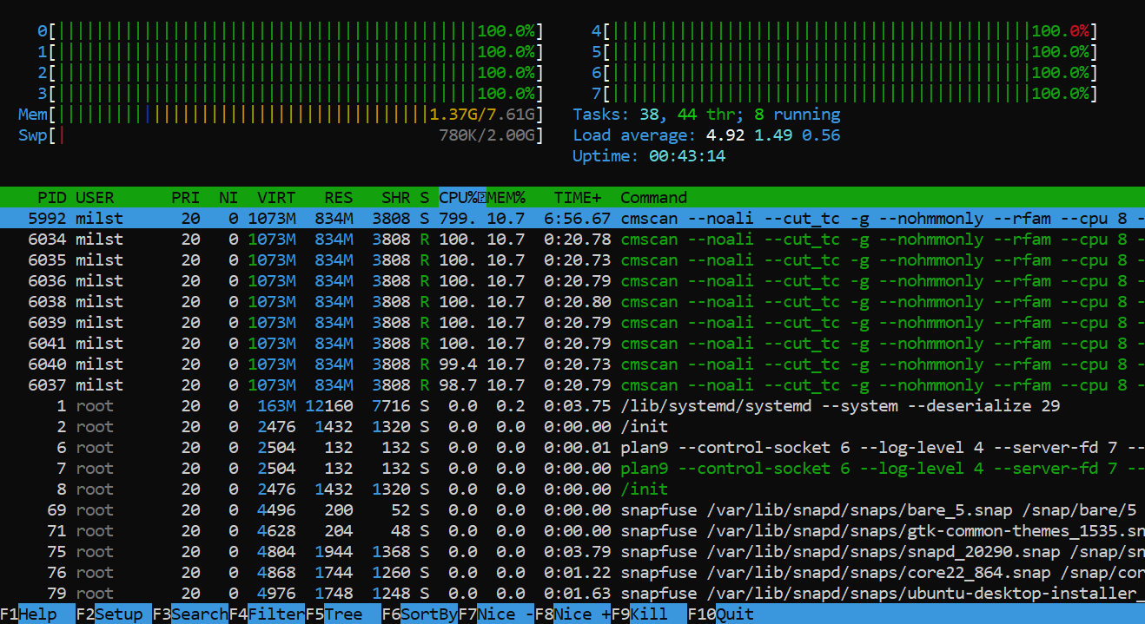
htop

Slide 10
This is too hard!
This is a lot of stuff for beginners
Talk to each other and ask the teachers
Don’t be afraid to play around
I have made it slightly too hard on purpose!
Now you HAVE to ask me!

Slide 11
Genome download and annotation
Exercise 1
Get the environments working
Download the genomes
Exercise 2
Genome annotation
Loops
You can go home when you have annotated all your genomes

Slide 12
Genome assembly and what we can get
Mikael Lenz Strube (milst@dtu.dk)

